Slide 1

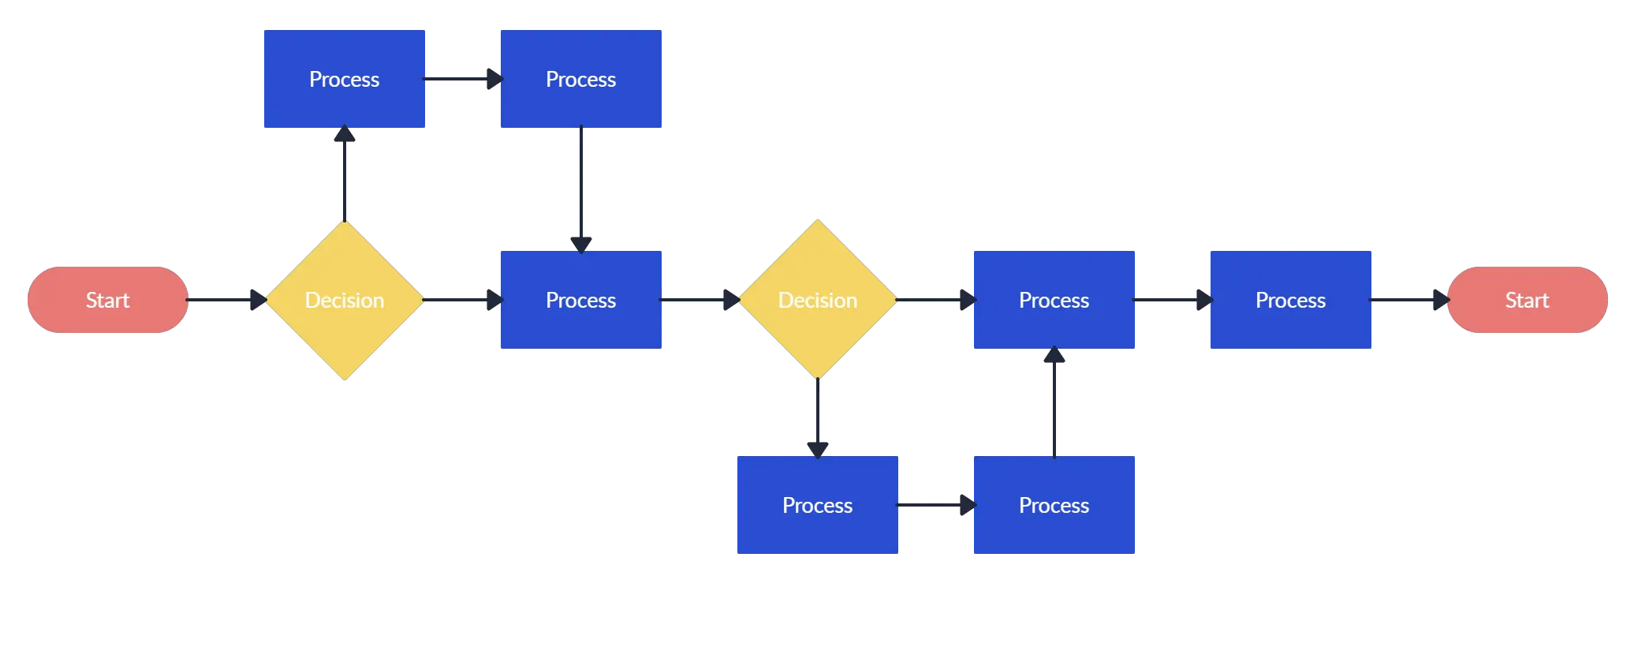
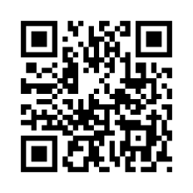
Poster Title
Authors¹
¹Affiliations
Introduction
Materials and Methods
Use incomplete sentences
Smallest size body text 36
Keep word count to minimum
Image
Use incomplete sentences
Smallest size body text 36
Keep word count to minimum
Fig X: sentence long description of image/figure. Min size 18.
Image
Image
Image
Image
Use incomplete sentences
Smallest size body text 36
Keep word count to minimum
Fig X: sentence long description of image/figure. Min size 18.
Fig X: sentence long description of image/figure. Min size 18.
Fig X: sentence long description of image/figure. Min size 18.
Fig X: sentence long description of image/figure. Min size 18.
Results
Conclusions
Use incomplete sentences
Smallest size body text 36
Keep word count to minimum
Pie Chart
Graph
Use incomplete sentences
Smallest size body text 36
Keep word count to minimum
Fig X: sentence long description of image/figure. Min size 18.
Fig X: sentence long description of image/figure. Min size 18.
Graph
Image
Graph
Image
References & Acknowledgements
Fig X: sentence long description of image/figure. Min size 18.
Fig X: sentence long description of image/figure. Min size 18.
Fig X: sentence long description of image/figure. Min size 18.
Fig X: sentence long description of image/figure. Min size 18.
This is the one section you can use complete sentences to thank those that helped you on your project. Include whoever you would like. Additionally, don’t forget about your logos. You need the KEYS, BIO5, and Ken R. Coit College of Pharmacy logo and those required by your lab.

